Slide 1
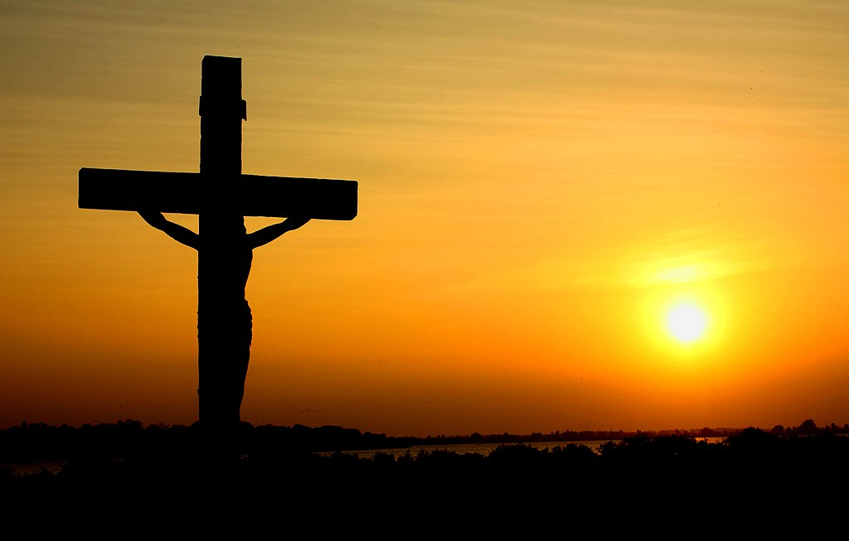
THROUGH THE BIBLE IN 2018
LESSON 18
WEEK 18 OF 52
(Psalms; 2Sam.5
1Chron.11-16)
Last time we saw the death of Saul; this time the coronation of Israel’s
greatest king, David.
The Psalms written by David are a glimpse into the
man whose heart was after that of God. He had fled Saul and many times escaped death only because of
the protective hand of God. One can hear the pain in
his voice of one who is bearing insufferable burdens –
“Hear my prayer, O LORD, and let my cry come unto thee. Hide not thy face from me in the day when I
am in trouble; incline thine ear unto me…”
(Psa. 102:1,2).
This is one of many Messianic psalms where David, unknowingly, illustrated the pain and sufferings of
Christ through events in his own life.

Slide 2
“For he hath looked down from the height of his sanctuary; from heaven did the LORD behold the earth; To hear the groanings of the prisoner; to loose those that are appointed to death; to declare the name of the LORD in Zion, and his praise in Jerusalem… He weakened my strength in the way; he shortened my days…”
(102:19-23).
The Messiah would become the prisoner for mankind, utter groanings from the Cross, become weakened unto death, His life shortened to carry out the Father’s plan of redemption –
“Who forgiveth all thine iniquities… who redeemeth thy life from destruction…” (103:3,4).
David could not have possibly known that all of which he spoke would be accomplished by the Son of God on Mt. Calvary.

Slide 3
“As far as the east is from the west, so far hath
he removed our transgressions from us” (103:12).
Christ’s finished work totally separated the-sin-from-
the-sinner—man’s record of sin was expunged by the
selfless gift of Christ so much so that David said…
“… thou art very great; thou art clothed with honour
and majesty… who laid the foundations of the earth,
that it should not be removed for ever…” (104:1,5).
The Apostle Paul a thousand years later would add
to the importance of Christ –
“… we have redemption through his blood, even the
forgiveness of sins: [Christ] Who is the image of the
invisible God… for by him were all things created,
that are in heaven, and that are in earth, visible and
invisible… all things were created by him, and for
him…” (Col. 1:14-16). The Creator of everything became the sin bearer for everyone.

Slide 4
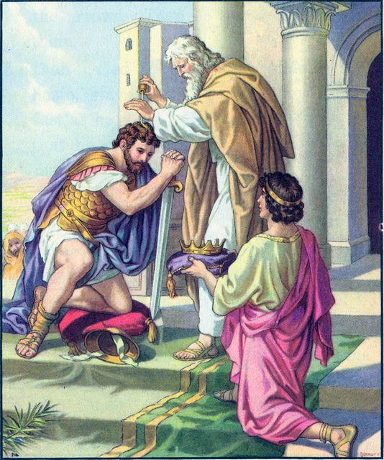
THE KING OF ISRAEL
“Then came all the tribes of Israel to David unto Hebron… and king David made a league with them in Hebron before the LORD: and they anointed David king over Israel. David was [30] years old when he began to reign, and reigned [40] years. In Hebron he reigned over Judah [7 ½] years: and in Jerusalem he reigned [33] years over all Israel and Judah”(2Sam. 5:1-5).
The plan had now been carried out to make David the God-chosen king of all Israel. The first capital was Hebron, but God made it possible for it to be moved
to where He wanted it, Jerusalem –
“And the king [David] and his men went to Jerusalem unto the Jebusites, the inhabitants of the land… saying, Except thou take away the blind and the lame, thou shalt not come in hither: thinking, David cannot come in hither” (5:6).

Slide 5
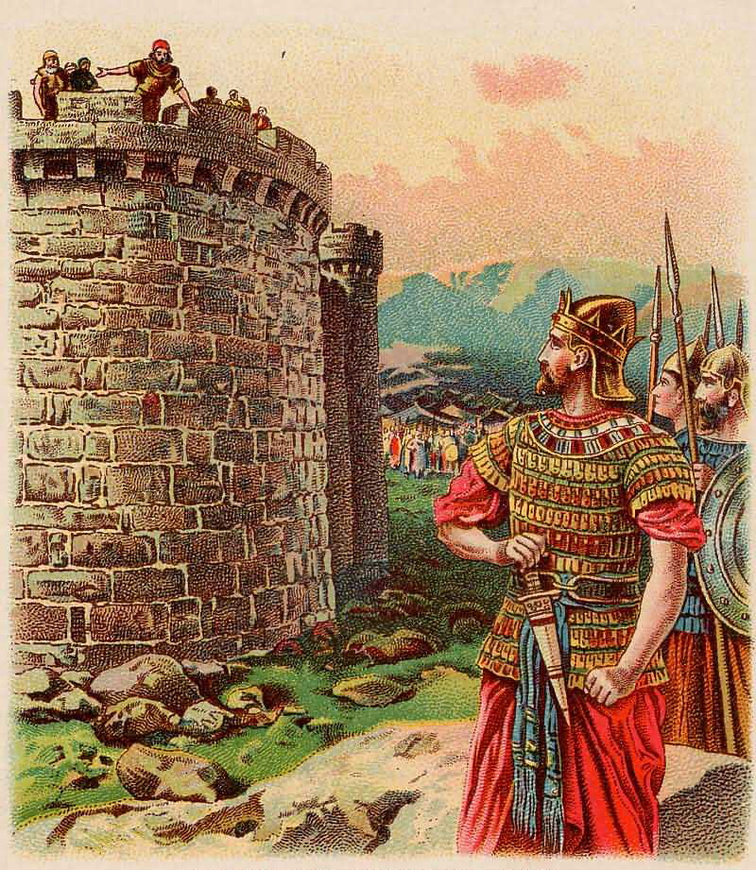
DEFEAT OF THE JEBUSITES
The Jebusites mocked David because they believed their city was impenetrable. In effect they said, Even the blind and the lame can ward you off, David!
They underestimated David, and they certainly underestimated God’s power and plan to take ‘the city of God’ –
“Great is the LORD, and greatly to be praised in the city of our God, in the mountain of his holiness… is mount Zion… the city of the great King” (Psa. 48:2).
“Nevertheless David took the strong hold of Zion…” (5:7).
Jerusalem had been held by the pagan Jebusites since the time of Joshua when Judah was unable to take it (Josh. 15:63).
How did David take it?

Slide 6
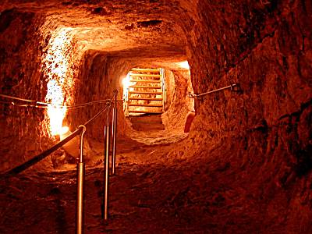
“And David and all Israel went to Jerusalem, which is Jebus; where the Jebusites were… And the inhabitants of Jebus said to David, Thou shalt not come hither. Nevertheless David took the castle of Zion, which is the city of David”
(1Chron. 11:4,5).
David offered the position of Commander-of-the-army to any soldier able to find an entry way into the fortified city (5:8). Joab discovered a water shaft, which led him beyond the walls, and David and his army then easily took ‘the city of God’ (1Chron. 11:6).
“So David dwelt in the fort, and called it the city of David. And David built round about from Millo and inward. And David went on, and grew great, and the LORD God of hosts was with him” (5:9).

Slide 7
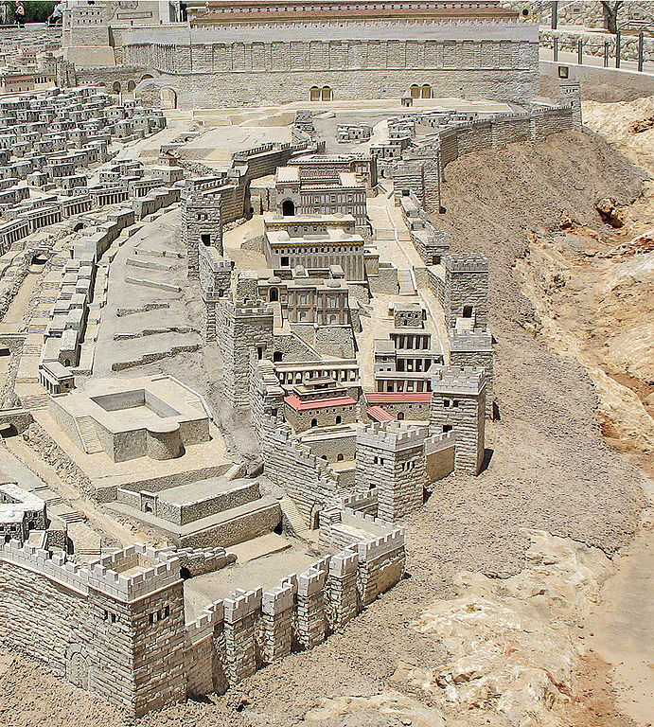
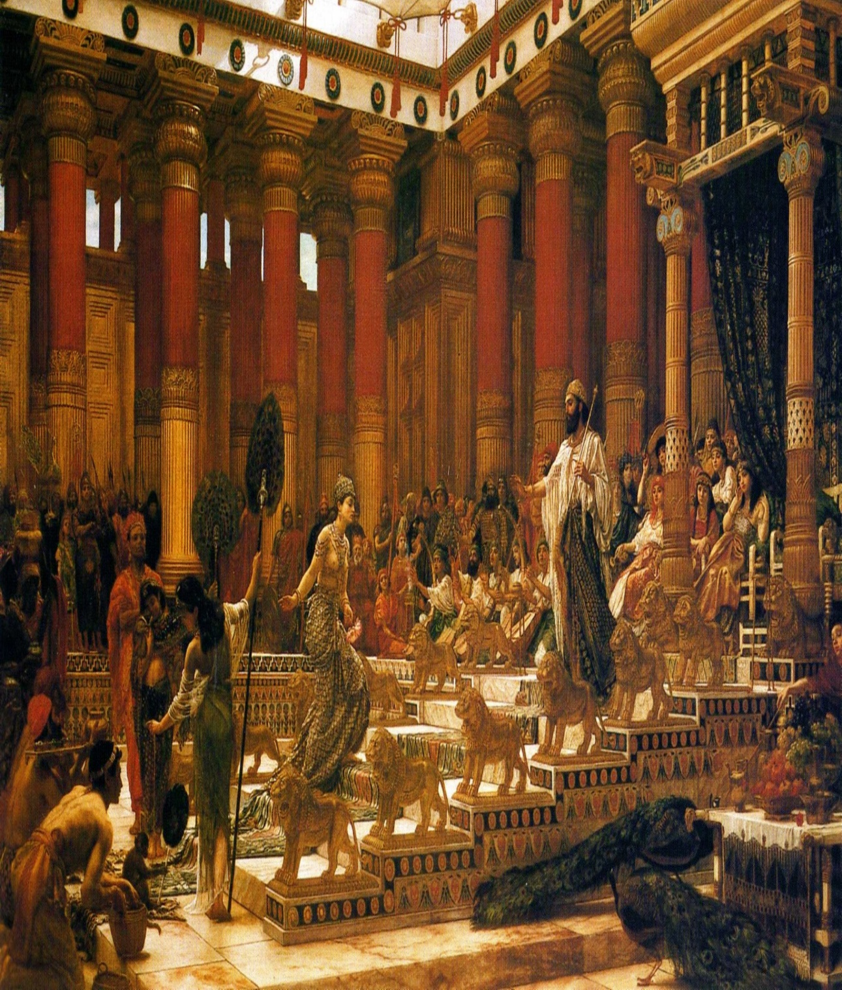
CITY OF DAVID
The original part of Jerusalem which he conquered,
he named ‘the city of David’ [not to be confused with
Bethlehem-Ephratah, the city of David’s birth –
“And Joseph also went up from Galilee… unto Judaea,
unto the city of David, which is called Bethlehem,
because he was of the house and lineage of David”
(Lk. 2:4).
Bethlehem was here referred to as ‘the city of David’
only in that it was the place of David’s birth and that
of the baby Jesus who would be in his lineage.
“And Hiram king of Tyre [Lebanon] sent messengers
to David, and cedar trees, and carpenters, and
masons: and they built David an house” (5:11).
The ascent to the throne over all Israel brought
David international fame recognized here by king
Hiram who supplied materials and craftsmen to build David a grand palace.

Slide 8
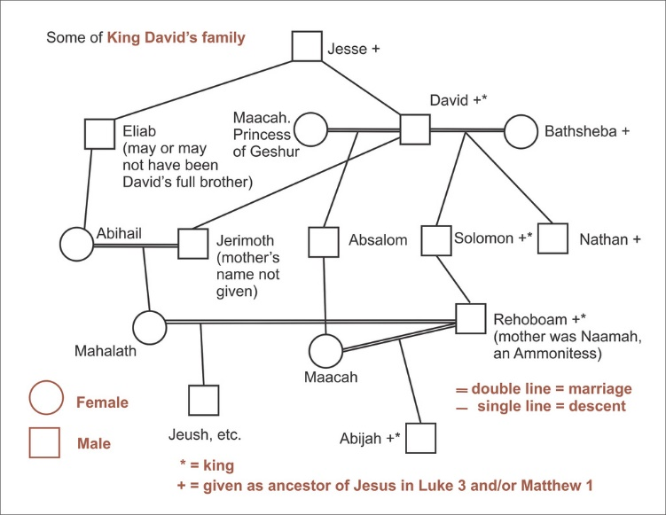
DAVID’S HAREM
“And David took him more concubines and wives out of Jerusalem, after he was come from Hebron: and there were yet sons and daughters born to David” (5:13).
In the ancient world, the leaders of nations often took wives + concubines, and David did the same. However, no where in the Hebrew scriptures, did God condone such a practice (Gen. 2:24).
DAVID’S ARMY
Not only did David expand his own family, but he added to the army he commanded –
“Now these are they that came to David to Ziklag, while he kept himself close because of Saul… and they were among the mighty men, helpers of the war” (12:1).
Most of David’s early recruits were from his own tribe of Judah when he tried to escape the threats from Saul.

Slide 9
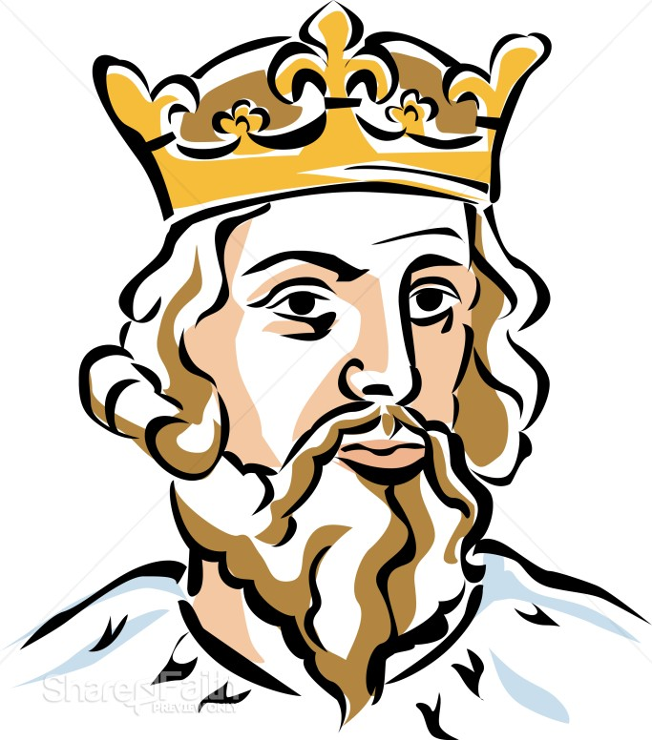
From the time David became king of Judah, many soldiers from the other tribes of Israel came to encourage him to extend his kingdom—a total of more than 300,000 men. They were from Judah... Simeon… Levi… Benjamin… Ephraim… [west] Manasseh… Issachar… Zebulon… Naphtali… Dan… Reuben… Gad… [east] Manasseh…”
(12:23-40).
David expanded his army to include all 12 tribes thus consolidating his power and showing no partiality to specific tribes.
The nation’s reaction?
“… for there was joy in Israel” (12:40).
For the moment, Israel under the rule of King David was where God wanted them to be.

Slide 10
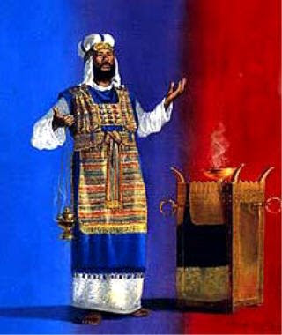
PSALMS
“Behold, how good and how pleasant it is for brethren to dwell together in unity! It is like the precious ointment upon the head, that ran down upon the beard, even Aaron’s beard: that went down to the skirts of his garments. As the dew of [Mt.] Hermon, and as the dew that descended upon the mountains of Zion: for there the LORD commanded the blessing, even life for evermore” (Psa. 133:1-3).
Notice the change in David’s mood from one of fear and despair to one of joy and adulation now that he is king over Israel and has the blessings of God on his side.
“They did not destroy the nations, concerning whom the LORD commanded them: But were mingled among the heathen… served their idols…” (106:34,35).
David knew the past sins of Israel especially the worship of idols, and he would do his best to not let that happen again.

Slide 11
A HYMN OF PRAISE
“O give thanks unto the LORD, for he is good… gathered
them out of the lands… they wandered in the wilderness…
hungry and thirsty… and he led them forth by the right
way, that they might go to a city of habitation…” (107:1-7).
A praise psalm thanking God for not giving up on them
despite their unfaithfulness, and finally getting them to a
land and a city [Jerusalem] that would be their own.
THE WORSHIP CENTER MOVED
“And David said unto all the congregation of Israel… also
the priests and Levites which are in the cities and suburbs,
that they may gather themselves unto us: And let us bring
the ark of our God to us… And all the congregation said
that they would do so: for the thing was right in the eyes
of all the people” (1Chron. 13:1-4).
David believed it was time to make Jerusalem the worship center of Israel, and the people agreed.

Slide 12
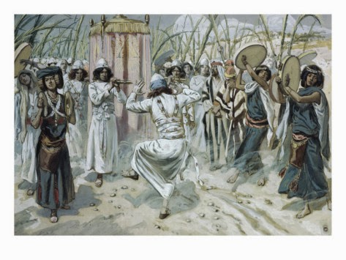
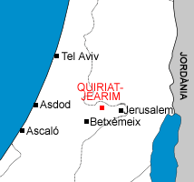
THE ARK MOVED
“So David gathered all Israel together… to bring the ark of God from Kirjath-jearim… which belonged to Judah… and they carried the ark of God in a new cart out of the house of Abinadab: and Uzza and Ahio drave the cart. And David and all Israel played before God… with singing, and with harps… timbrels… cymbals… trumpets” (13:5-8).
David yearned to make Jerusalem the center of worship as well as the capital of Israel, so they went to Kirjath-jearim where the ark had been housed for the past 100 years [1104-1003 B.C.] after having had it returned from the Philistines — a distance of 1O miles. It was a joyous occasion with David leading the procession.

Slide 13
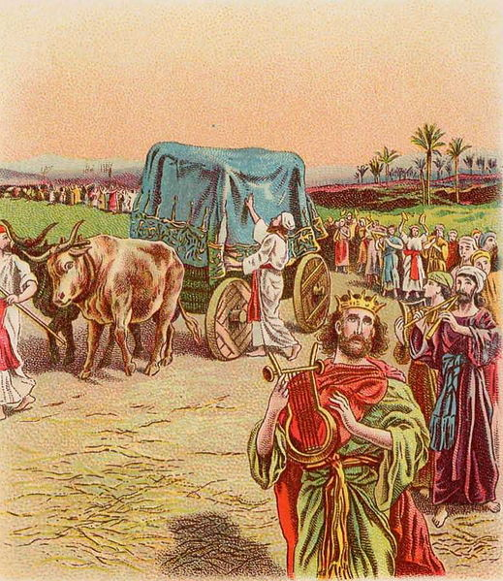
TRAGEDY
“And when they came unto… Chidon, Uzza put forth his hand to hold the ark; for the oxen stumbled. And the anger of the LORD was kindled against Uzza, and he smote him, because he put his hand to the ark: and there he died before God” (13:9,10).
There were 2-problems:
1. The ark was not to be touched because of it’s holiness, but carried by staves through rings connected to the ark (Exo. 25:14,15)
2. The ark was being transported on a cart which made it susceptible to falling
David was angered at God (13:11) and feared moving the ark further (13:12). He carried the ark to a nearby house, Obed-edom, where it remained 3-months (13:13,14).

Slide 14
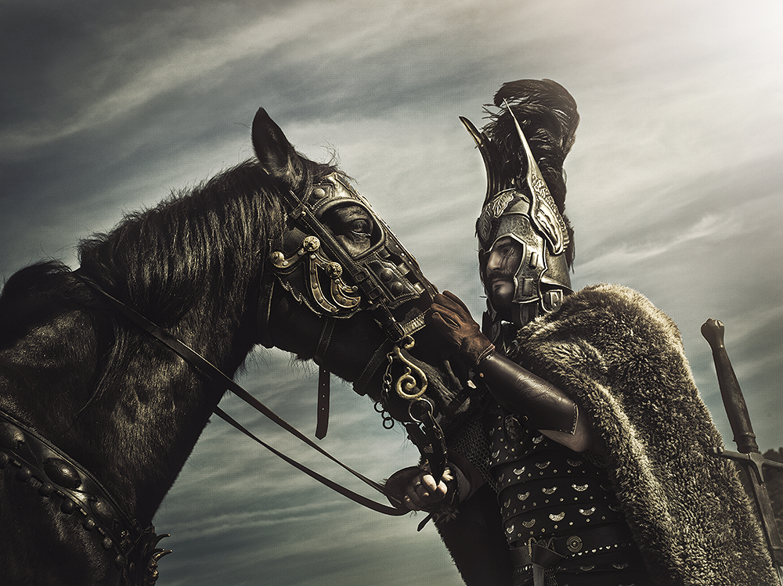
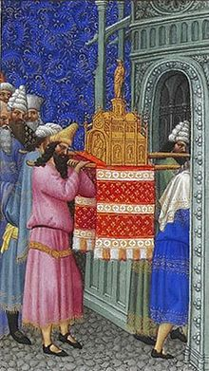
DAVID’S SUCCESS
“… that thou shalt go out to battle: for God is gone before thee to smite the host of the Philistines. David therefore did as God commanded him: and they smote the host of the Philistines from Gibeon even to Gazer. And the fame of David went out into all lands; and the LORD brought the fear of him upon all nations” (14:15,16).
God wanted the pagans to fear Israel and their king, which had not been the case since Joshua entered the land.
PROPER PROTOCAL
“And David made him houses in the city of David, and prepared a place for the ark of God… Then David said, None ought to carry the ark of God but the Levites: for them hath the LORD chosen to carry the ark… and David gathered all Israel together in Jerusalem, to bring up the ark of the LORD unto his place, which he had prepared for it” (15:1).
This time David followed the requirements of the Law.

Slide 15
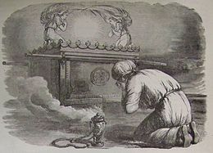
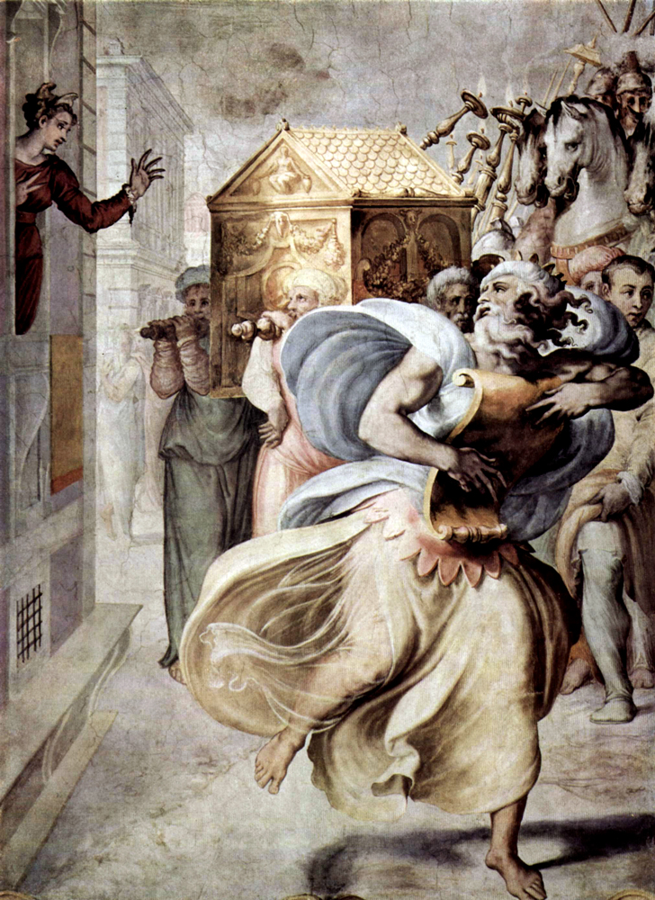
THE ARK ARRIVES IN JERUSALEM
“So David, and the elders of Israel… went to bring up the ark… out of the house of Obed-edom with joy…” (15:25-28).
David again led the short processional and this time brought the ark to the holy city, but his wife, Michal, did not approve of his public show of emotion (15:29).
“So they brought the ark of God, and set it in the midst of the tent that David had pitched for it: and they offered burnt-sacrifices and peace offerings before God” (16:1).
Finally, the ark had reached its final destination, Jerusalem. They celebrated with sacrifices and offerings to God, but it had not quite reached its home, yet.
Stay tuned for that.

Slide 16
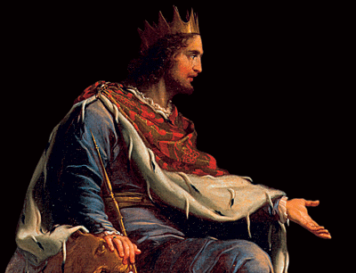
PSALMS
“Blessed is the man that walketh not in the counsel of the ungodly… But his delight is in the law of the LORD; and in his law doth he meditate day and night” (Psa. 1:1).
Israel was at peace, their king [David] sat on the
throne in Jerusalem, and the ark was there for people to worship God and to keep His Law.
“Why do the heathen rage, and the people imagine a vain thing? The kings of the earth set themselves, and the rulers take counsel together, against the LORD, and against his anointed, saying, Let us break their bands asunder, and cast away their cords from us” (1:2).
David was not naïve as he knew the Gentiles nations plotted and planned to overthrow the will of God.

Slide 17
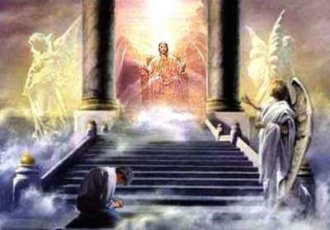
“He that sitteth in the heavens shall laugh: the LORD shall have them in derision. Then shall he speak unto them in his wrath, and vex them in his sore displeasure. Yet have I set my king upon my holy hill of Zion… Thou art my Son;
this day have I begotten thee” (2:4-7).
Next David gave the answer from God to the
plotting of the evil nations… GOD LAUGHS AT IT!
How foolish for man to think he can thwart the plans, purposes, and will of Almighty God!
Looking through the portal of time, David gives the reader a glimpse of what lies ahead…
GOD WILL POUR OUT HIS WRATH UPON AN UNBELIEVING EARTH!! THE TRIBULATION!!!
After 7-years of hell on earth, God will send His Son to usher in 1,000-years of kingdom peace.

Slide 18
“LORD, who shall abide in thy tabernacle? Who shall dwell in thy holy hill? He that walketh uprightly, and worketh righteousness, and speaketh truth in his heart” (15:1,2).
David asked the question, Who, LORD, will be part of the earthly kingdom promised to Israel? The answer—the righteous. Those who believe the God of Israel [faith] and keep His Laws [works].
“My God, my God, why hast thou forsaken me?... But I am a worm, and no man; a reproach of men, and despised of the people… My tongue cleaveth to my jaws… they pierced my hands and my feet… part
my garments… cast lots…” (22:1-21).
The most graphic of all the Messianic psalms.

Slide 19
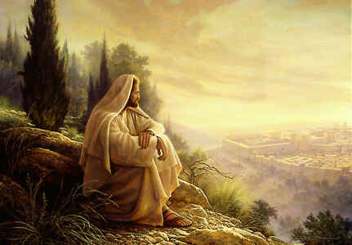
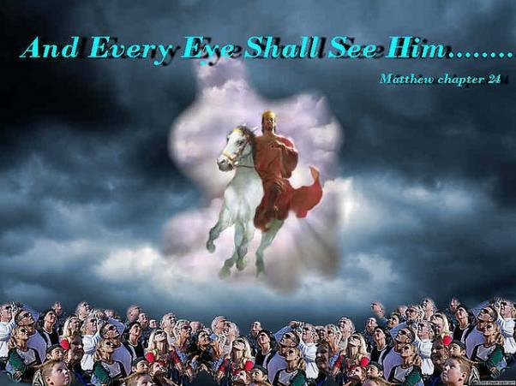
“The LORD is my shepherd; I shall not want… yea,
though I walk through the valley of the shadow
of death, I will fear no evil: for thou art with me…”
(23:1-6).
This most well-known prophetic psalm has many,
many applications—Christ’s own death; Israel
facing her many enemies that surrounded her;
the period of the tribulation, et. al.
“The earth is the LORD’S… Who shall ascend into
the hill of the LORD? Who shall stand in his holy
place? He that hath clean hands, and a pure
heart… the King of glory shall come in… Who is
this King of glory? The LORD of hosts, he is the
King of glory” (24:1-10).
Psa. 22-24 – Who is the only worthy One?
The One who died an insufferable death but will return in glory to rule over the earth forever!

Slide 20
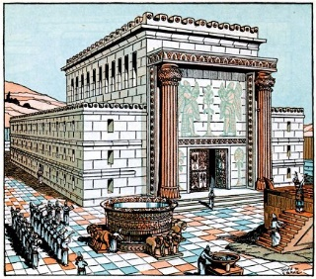
“O clap your hands, all ye people; shout unto God with
the voice of triumph… he is a great King over all the earth
(47:1,2)… The earth shook, the heavens also dropped at
the presence of God… (68:8)… My covenant I will not
break… once I have sworn by my holiness… His seed shall
endure for ever, and his throne as the sun before me...
(89:34-36)… Let the heavens rejoice, and let the earth be
glad… for he cometh to judge the earth: he shall judge
the world with righteousness, and the people with his
truth (96:11-13)… For the LORD is good; his mercy is
everlasting; and his truth endureth to all generations
(100:5)… I [David] will not give sleep to mine eyes, or
slumber to my eyelids, until I find a place for the LORD…”
(132:4,5).
David will not rest until he finds a suitable dwelling place
for the GOD who will one day rule over the earth!
Next time – David sins with Bathsheba

