Slide 1
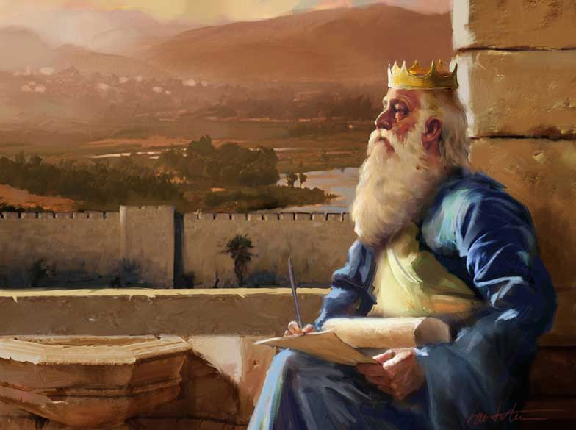
THROUGH THE BIBLE IN 2018
LESSON 21
WEEK 21 OF 52
(2Sam. 22-24;
1Chron.21-29)
Though David’s sin with Bath-sheba would bring devastating results in his own family, at the end of his life his kingdom would be a model on earth.
“And David spake unto the LORD the words of this song in the day the LORD delivered him out of the hand of all his enemies, and out of the hand of Saul: And he said, The LORD is my rock… fortress… deliverer… shield… horn of my salvation… high tower… refuge … savior… I will call on the name of the LORD, who is worthy to be praised: So shall I be saved from mine enemies” (2Sam. 22:1-3).
David hoped to live out his life praising the LORD for all that He had been to him. Again David thanked God for delivering him from the enemies of Israel who would kill him and destroy his nation if possible.

Slide 2
Now in his advanced years, David wrote a poem of his life –
“Now these are the last words of David… the son of Jesse… and the man who was raised up on high, the anointed of the God of Jacob, and the sweet psalmist of Israel, said, The Spirit of the LORD spake by me, and his word was in my tongue” (23:1,2).
From his humble beginning in Bethlehem, the son of
Jesse, and a lowly shepherd, David from a young age
knew he was destined to become God’s choice as king
of Israel. But, he was more than a mighty warrior—he
was a writer of the praises of God [Psalms], an author
of Scripture, and revealer of thoughts and actions of
the God of the universe through the Holy Spirit. And,
through him had God given the DAVIDIC COVENANT –
“Although my house be not so with God: yet he hath
made with me an everlasting covenant…” (23:5).
The house of David was not sinless, but God promised
future kings would sit on his throne and rule Israel.

Slide 3
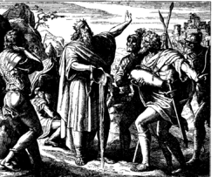
DAVID’S MIGHTY MEN
After a brief poem extolling the accomplishments the LORD had placed on his life, David next recorded a list of 37 heroes with whom he had fought in his life –
“These be the names of the mighty men whom David had: The Tachmonite that sat in the seat, chief among the captains; the same was adino the Eznite: he lift ups his spear against eight hundred, who he slew at one time. And after him was Eleazar the son of Dodo the Ahohite, one of the three mighty men with David, when they defied the Philistines that were gathered together to battle, and the men of Israel were gone away; He arose, and smote the Philistines until his hand was weary, and his hand clave unto the sword: and the LORD wrought a great victory that day… Uriah the Hitite: [37] in all”
(23:8-39).

Slide 4
“My soul is among lions: and I lie even among them that are set on fire, even the sons of men, whose teeth are spears and arrows, and their tongue a sharp sword” (Psa. 57:4).
David lived an active life, but he was not alone as many others like him were God-driven, God-fearing men of action.
“For the LORD is a great God, and a great King above all gods (95:3)… The LORD reigneth; let the earth rejoice; let the multitude of the isles be glad thereof (97:1)… The LORD hath made known his salvation…He hath remembered his mercy and his truth toward the house of Israel (98:2,3)… The LORD reigneth; let the people tremble… let the earth be moved… He is high above all the people” (99:1,2).
Though David was perhaps the greatest of all warriors and Israel’s mightiest king, he stood in awe of the God who had
made everything possible—he was humbled to be used to
carryout His will, and he always gave God the credit.

Slide 5
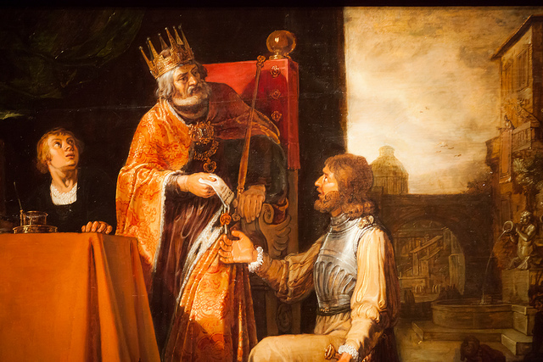
DAVID ERR’S AGAIN
“And again the anger of the LORD was kindled against Israel, and he moved David against them to say, Go, number Israel and Judah” (2Sam. 24:1).
Though David was nearing the end of his life and had the knowledge of God’s power and presence with him which had brought peace against his enemies, he made a bad decision to allow his pride to number his military –
“For the king said to Joab the captain of the host… Go now through all the tribes of Israel, from Dan to Beer-sheba, and number ye the [soldiers]… And Joab gave up the sum of the [soldiers] unto the king: and there were in Israel [800,000] valiant men that drew the sword; and the men of Judah were [500,000] men” (24:1-9).
David’s census of his fighting force offended the LORD because it emphasized David’s army—
N0T THE LORD’S!

Slide 6
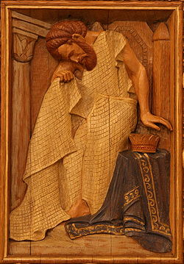
“And David’s heart smote him after that he had numbered the people, And David said unto the LORD, I have sinned greatly in that I have done: and now, I beseech thee, O LORD, take away the iniquity of thy servant: for I have done very foolishly” (24:10).
To err is human—Just when it looked like David had become the great spiritual man of God that he wrote about in the psalms, he proved that he was just like each of us, which is being capable of making mistakes and using bad judgment.
So, what did God do?
“For when David was up in the morning, the word of the LORD came unto the prophet Gad, David’s seer, saying, Go and say unto David… I offer thee three things; choose thee one of them that I may do it unto thee” (24:11,12).
3 choices: 7-years of famine; flee 3-months from an enemy; 3 days of pestilence (24:13). What would you choose?

Slide 7
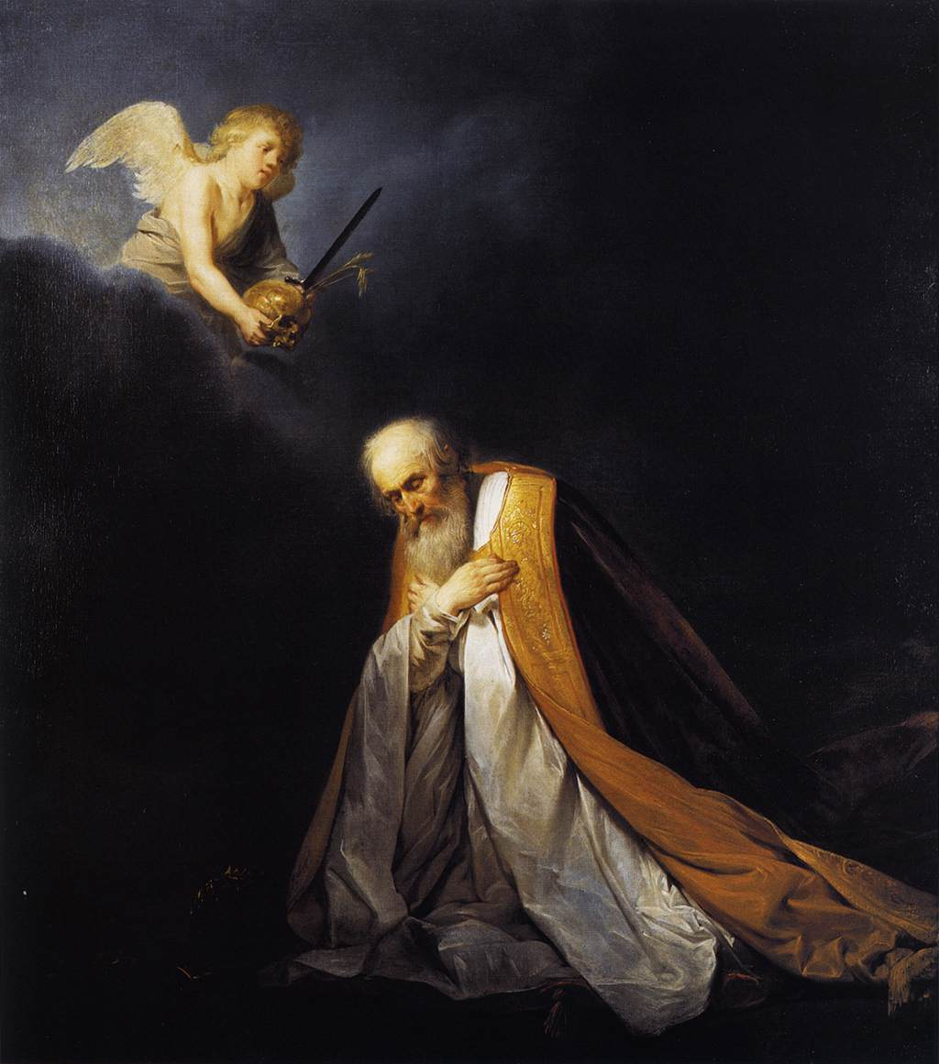
DAVID’S CHOICE
“And David said unto Gad, I am in a great strait: let us fall now into the hand of the LORD; for his mercies are great: and let me not fall into the hand of man” (24:14).
David made the perfect choice. He would rather place himself under the chastisement of God who might render mercy, than to do the same with man who would be much less likely to do so.
“So the LORD sent a pestilence [plague] upon Israel from the morning even to the time appointed [3-days]: and there died of the people from Dan even to Beer-sheba [70,000] men. And when the angel stretched out his hand upon Jerusalem to destroy it, the LORD repented him of the evil… It is enough; stay now thine hand…” (24:15,16).
Israel [David] was punished with the death of 70,000 souls, but God showed mercy and destroyed not Jerusalem.

Slide 8
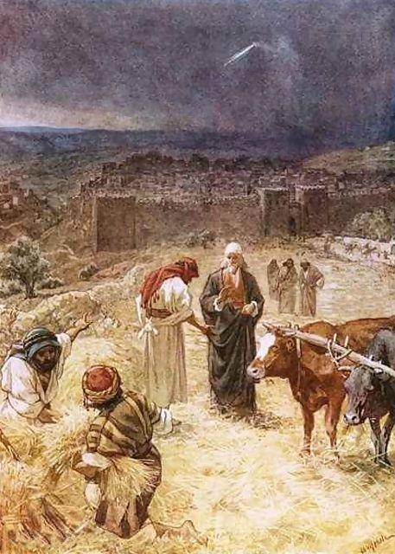
DAVID PURCHASES A THRESHING FLOOR
“And the angel of the LORD was by the threshing place of Araunah the Jebusite” (24:16).
The scene took place in Jerusalem where the prophet Gad instructed David to buy a nearby threshing floor in order to pay homage to the LORD after He mercifully ended the plague and did not destroy Jerusalem –
“And Gad came that day to David, and said unto him, Go up, rear an altar unto the LORD in the threshing floor of Araunah the Jebusite. And David, according to the saying of God, went up as the LORD commanded. And Araunah looked and saw the king and his servants coming toward him…” (24:18-20).
When asked what he wanted, David replied –
“To buy the threshing floor of thee, to build an altar unto the LORD” (24:21).

Slide 9
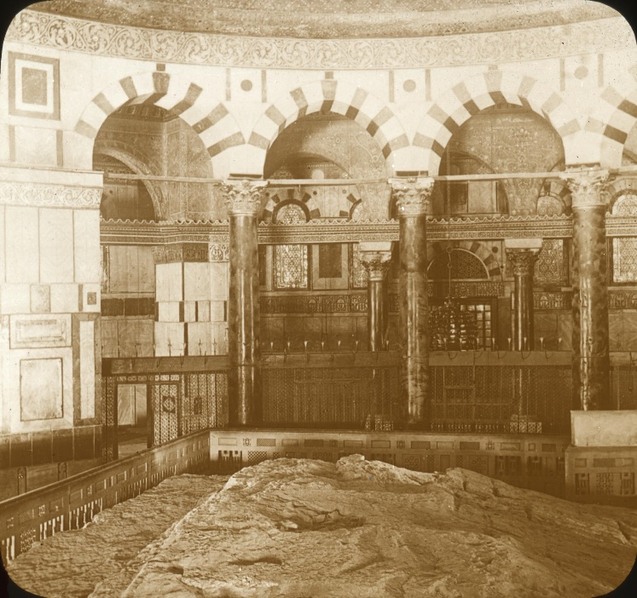
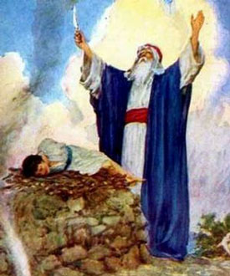
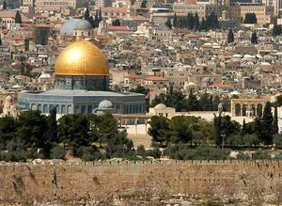
Araunah offered to give it to him, but David resisted and willingly paid 50-shekels of silver for the land & oxen for the sacrifice [Who owned the land? The king of Israel, 3,000 years ago] (24:22-24). David did as the LORD commanded –
“And David built there an altar unto the LORD, and offered burnt-offerings and peace-offerings …” (24:25).
Of course there is much more to this story.
It was on this sight [Mt. Moriah] that God had 900-years
earlier called Abraham to offer his son Isaac as a sacrifice
(Gen. 22:2).
In the future [6th century A.D.], it would be the site where Mohammed would build the ‘Dome of the Rock,’ and regard it as the 2nd most holy site of Islam.
Even further into the future, during the tribulation, it will
be where the Antichrist will sit in the rebuilt temple and
call himself God (2Thess. 2:4).

Slide 10
“And David built there an altar unto the LORD, and offered burnt-offerings and peace-offerings, and called upon the LORD; and he answered him from heaven by fire upon the altar of burnt-offering. And the LORD commanded the angel; and he put his sword again into the sheath thereof.
“At that time when David saw the LORD had answered him in the threshing floor of Ornan [Araunah] the Jebusite, then he sacrificed there. For the tabernacle of the LORD, which Moses made in the wilderness, and altar of the burnt-offering, were at that season in the high place at Gibeon. But David could not go before it to enquire of God: for he was afraid because of the sword of the angel of the LORD” (1Chron. 21:29,30).
David made this site his regular place of worship just north of the city walls, no longer going to the tabernacle in Gibeon, which he perceived by the angel’s sword not to do.

Slide 11
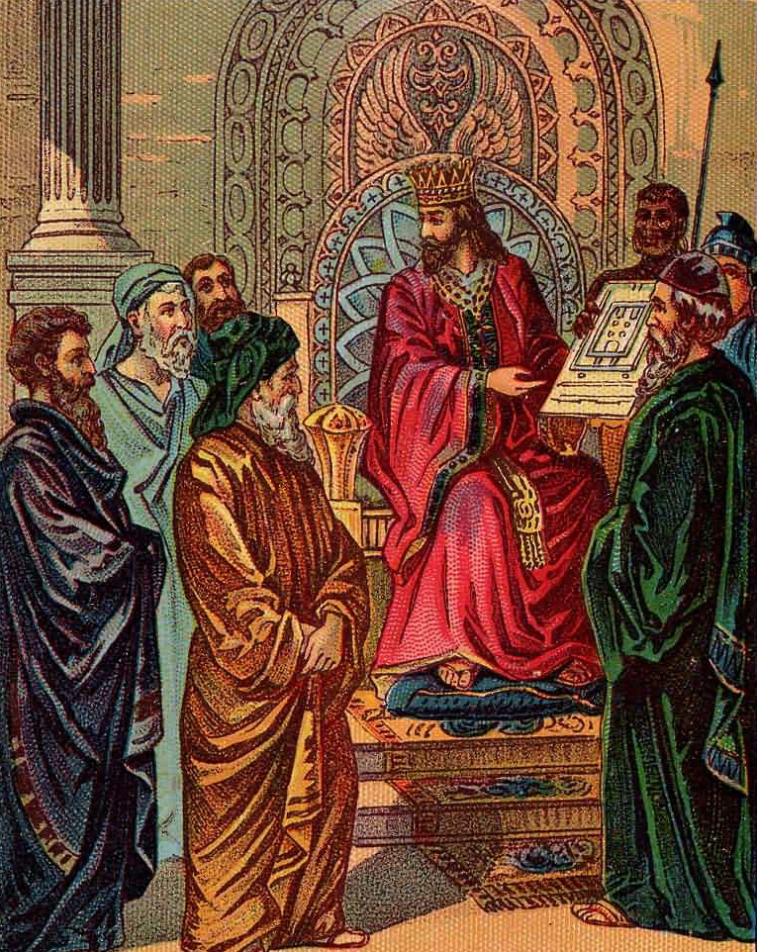
SITE OF THE FUTURE TEMPLE
“Then David said, This is the house of the LORD God, and this is the altar of the burnt-offering for Israel” (22:1).
Previously, David had desired to built a permanent place of worship in Jerusalem, but was not given permission to do so. Now that God had chosen the site David prepared the blueprint, materials and workman to carry out the task –
“And David commanded to gather together… masons to hew wrought stones to build the house of God. And David prepared iron in abundance for the nails for the doors of the gates, and for the joinings; and brass… Also cedar tress in abundance…” (22:2,3).
The best David could do was –
“… make preparation for it… before his death” (22:5).

Slide 12
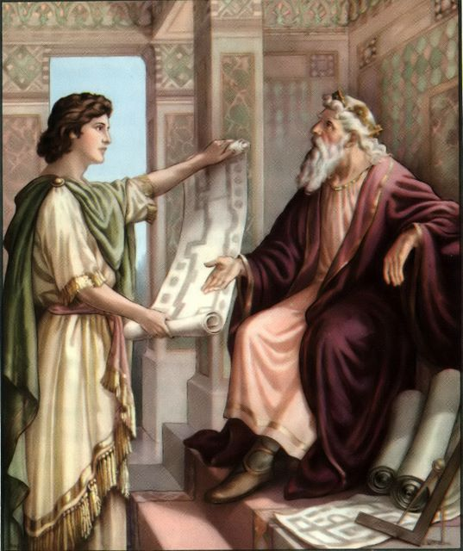
SOLOMON CHOSEN TO BUILD THE TEMPLE
“Then he called for Solomon his son, and charged him to build an house for the LORD God of Israel” (22:6).
Though David had desperately wanted to build the temple, he had been told of God he wouldn’t. Why?
“And David said to Solomon, My son, as for me, it was in my mind to build an house unto the name of the LORD… But the word came to me, saying, Thou has shed blood abundantly, and hast made great wars:
thou shalt not build an house unto my name, because thou hast shed much blood upon the earth in my sight. Behold, a son shall be born to thee, who shall be a man of rest; and I will give him rest from all his enemies round about: for his name shall be Solomon, and I will give peace and quietness unto Israel in his days. He shall build an house for my name…”
(22:7-10).

Slide 13
SOLOMON’S CHARGE
“He shall build an house for my name… I will establish
the throne of his kingdom over Israel forever” (22:11).
Solomon would succeed David in God’s promise of an
eternal king and kingdom.
“Only the LORD give thee wisdom and understanding,
and give thee charge over Israel, that thou mayest
keep the law of the LORD thy God” (22:12). David told Solomon what he had accrued for the temple: 3,700 tons of gold; 3,700 tons of silver = 7.4 tons!
“Now set your heart and your soul to seek the LORD
your God; arise therefore, and build ye the sanctuary
of the LORD God, to bring the ark of the covenant of
the LORD, and all the holy vessels of God, into the
house that is to be built to the name of the LORD (22:19)… So when David was old and full of days, he made Solomon his son king over Israel” (23:1).

Slide 14
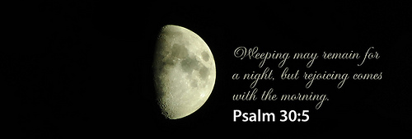
“Sing unto the LORD, O ye saints of his, and
give thanks at the remembrance of his
holiness. For his anger endureth but a
moment; in his favour is life: weeping may
endure for a night, but joy cometh in the
morning” (Psa. 30:4,5).
A PSALM AND SONG AT THE DEDICATION [site] FOR THE HOUSE OF DAVID
“I will praise thee, O LORD, among the people: I will sing praises unto thee among the nations…
Gilead is mine; Manasseh is mine, Ephraim also is the strength of mine head; Judah is my law
giver; Moab is my washpot; over Edom will I cast my shoe; over Philistia will I triumph” (108:3-10).
Another imprecatory/Messianic psalm – ”For the mouth of the wicked and the mouth of the
deceitful are opened against me: they have spoken against me with a lying tongue… Set thou a
wicked man over him: and let Satan stand at his right hand. When he shall be judged, let him be
condemned: and let his prayer become sin. Let his days be few; and let another take his office”
(109:1-8).
This foreshadowed Judas’ betrayal of Jesus and replacement by Matthias (Acts 1:20).

Slide 15
“The LORD said unto my Lord, Sit thou at my right hand, until I make thine enemies thy footstool” (Psa. 110:1).
Another prophetic, Messianic psalm where David was given a revelation of the Father speaking to His Son [Messiah].
After the Son’s earthly ministry, death, burial, resurrection, and ascension back to heaven, the Father tells the Son to sit at His right hand until such time that He [Messiah] is sent back to earth [2nd coming] to subdue His enemies [end of tribulation] and usher in a 1,000 year kingdom of peace on earth. At that time, Messiah will be King over the whole earth –
“The LORD hath sworn, and will not repent, Thou art a priest for ever after the order of Melchizedek” (110:4).
Christ will not only be King but also High Priest after the order of Melchizedek, providing redemption to those Gentiles born in the millennium who will seek Him to be saved.

Slide 16
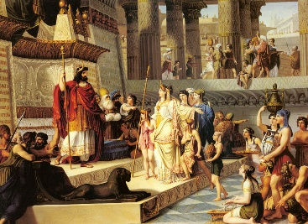
ONE GOVERNMENT
One of David’s last acts before his death was to reorganize the system of government over Israel –
“And he gathered together all the princes of Israel, with the priests and the Levites” (1Chron. 23:1).
This foreshadowed a future prophetic promise –
“For unto us a child is given [1st coming], unto us a son [man] is given [2nd coming]: and the government shall be upon his [Christ’s] shoulder… Of the increase of his government and peace there shall be no end, upon the throne of David, and upon his kingdom… to establish it with judgment and with justice from henceforth even forever” (Isa. 9:6,7).
The kingdom, the government, the system of justice, that began under David’s reign will reach its zenith during the 1,000-year earthly reign of Messiah!

Slide 17
“Let Israel hope in the LORD from henceforth and forever” (Psa. 131:3).
David could not have known the magnitude of the words he wrote in the psalms, but were exactly what God wanted and David was given the inspiration to write them down for posterity.
“I will worship toward thy holy temple, and praise thy name for thy lovingkindness and for thy truth: for thou hast magnified thy word above thy name” (138:2).
One of the most important verses in the Bible. Paul tells us that Christ’s name is above every name there is –
“Wherefore God [Father] also hath highly exalted him
[Christ], and given him a name which is above every name” (Phil. 2:9).
In this psalm, however, David wrote that the Holy Words given us in the Bible supersede even the name of Christ.

Slide 18
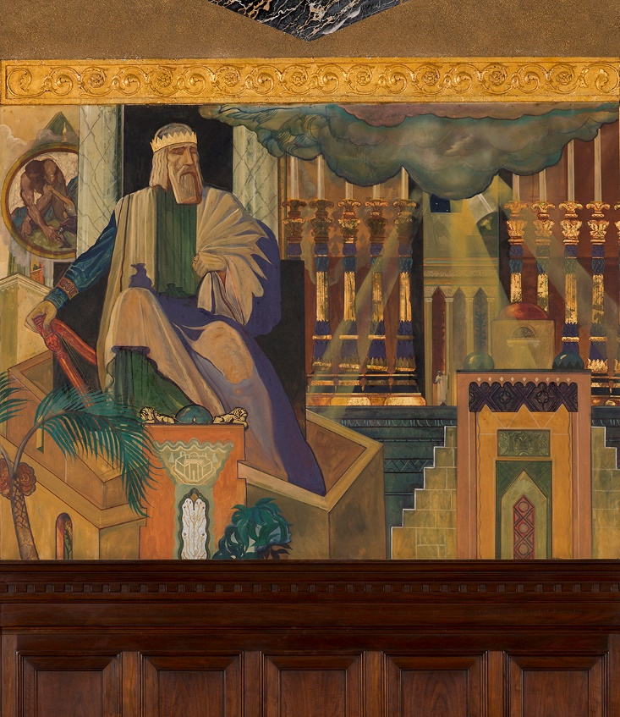
A SOLEMN ASSEMBLY
“And David assembled all the princes of Israel… the
captains of the companies… Then David Stood up
upon his feet, and said, Hear me, my brethren, and
my people…” (1Chron. 28:1,2).
In David’s last speech to the people of Israel, he tells
them that Solomon, not he, will build the temple
(28:3), and that Solomon will succeed him to the
throne (28:7). David had made the preparations
including drawings of the temple – “All this, said
David, the LORD made me understand in writing by
his hand upon me, even all the works of this pattern”
(28:19). The people responded by donating their
wealth toward the temple (29:7,8), “Then the people
rejoiced, for that they offered willingly, because with
perfect heart they offered willing to the LORD: and
David the king also rejoiced with great joy” (29:9). This moment was the closest Israel would get to the earthly kingdom of heaven—until Christ returns and establishes it Himself.

Slide 19
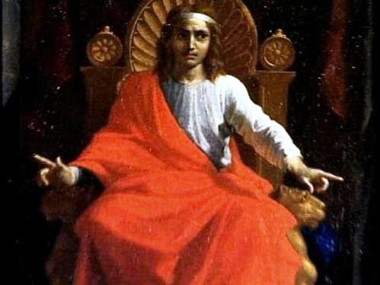
SOLOMON BECOMES KING
Then Solomon sat on the throne of the LORD as king instead of David his father… And the LORD magnified Solomon exceedingly in the sight of all Israel, and bestowed upon him such royal majesty as had not been on any king before him in Israel” (29:20-25).
Solomon sat on his father’s throne because the LORD had put him there. Solomon would begin his reign as king with a greater blessing from God than even his father David had received.
“Except the LORD build the house, they labour in vain that build it…” (Psa. 127:1).
His first venture would be to build the temple, or rather, oversee the construction that would be done by CHRIST HIMSELF!

Slide 20
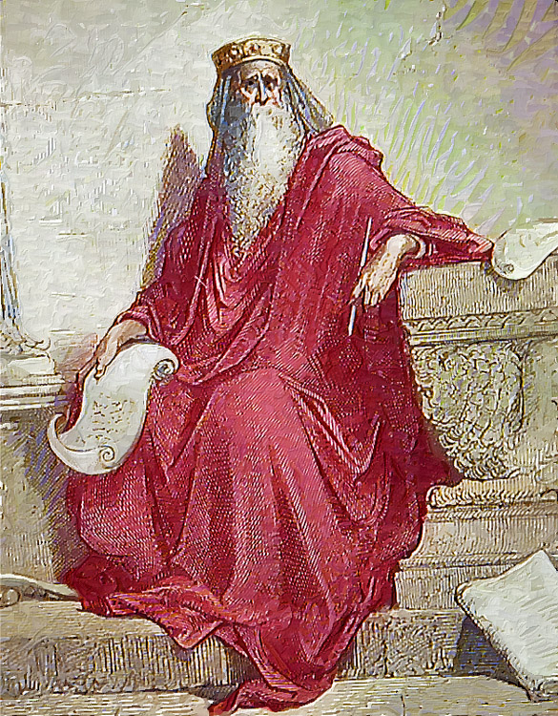
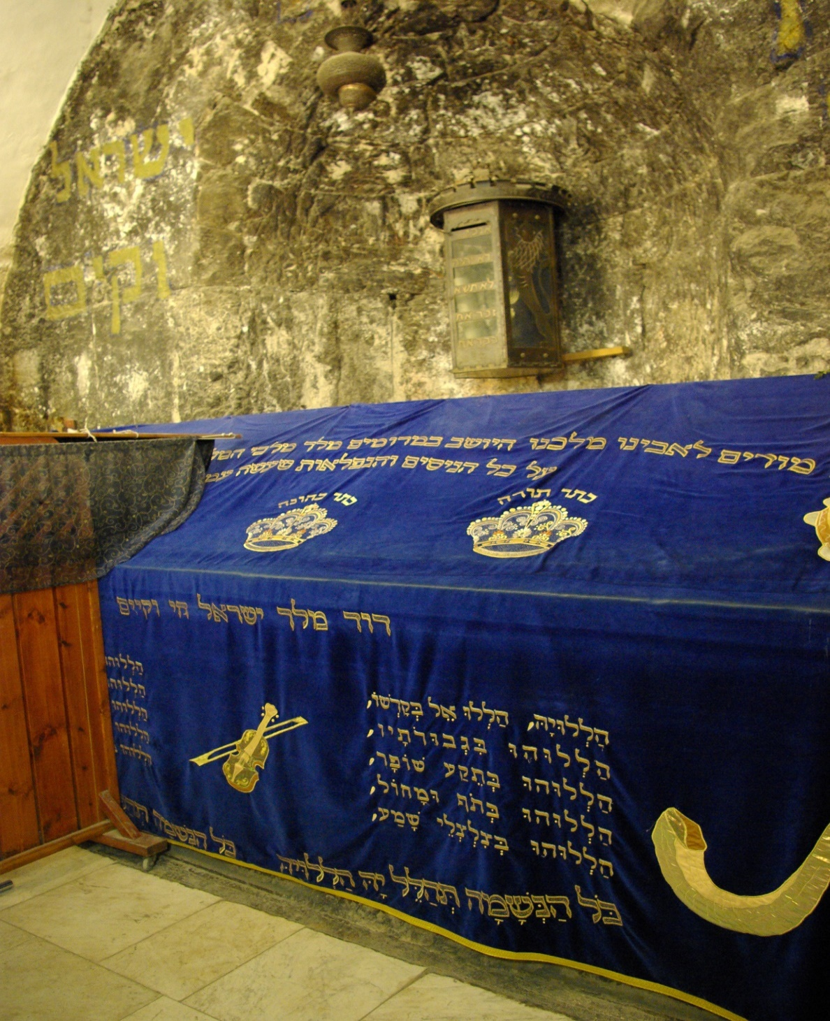
A GLIMPSE OF THE KINGDOM
“And David said to all the congregation, Now bless the LORD your God… all the congregation blessed the LORD
… bowed down their heads, and worshipped the LORD, and the King… And they offered sacrifices unto the LORD… And did eat and drink… with great gladness…”
(1Chron. 29:20-22).
This is what all Israel will do during the 1,000 year kingdom of heaven on earth. Christ will be their God,
and they will be His people—the Covenants fulfilled.
THE DEATH OF DAVID
“Thus David son of Jesse reigned over all Israel. And the time that he reigned over Israel was [40] years; [7] years reigned he in Hebron, and [33] years reigned he in Jerusalem. And he died in a good old age, full of days, riches, and honour” (29:28).
Next time – Solomon prepares to build the temple
David’s tomb on Mt. Zion, Jerusalem

